Slide 1
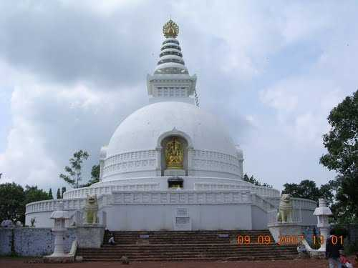
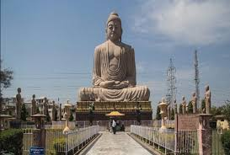
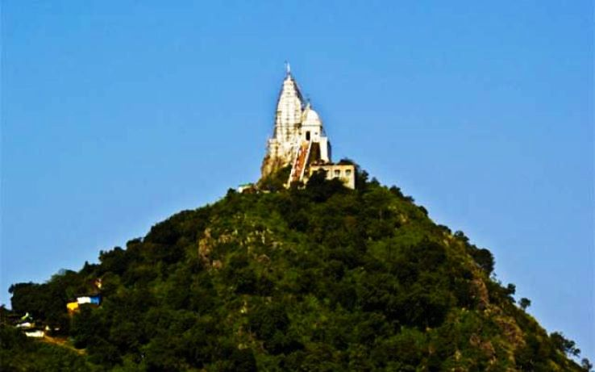
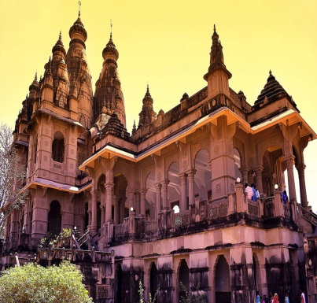
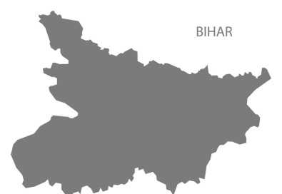
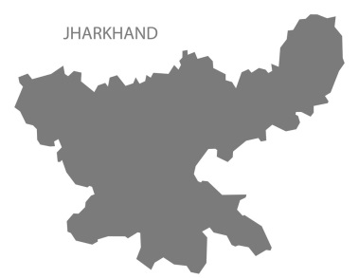
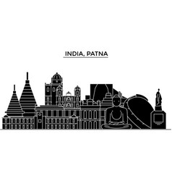
TOURIST ATTRACTIONS
OF BIHAR & JARKHAND

Slide 2
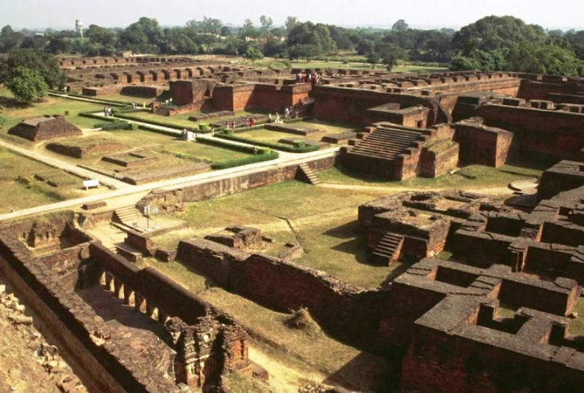
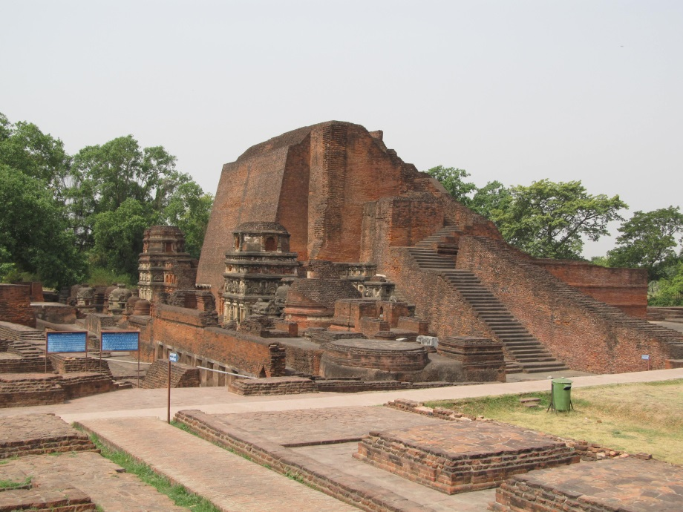
Nalanda
The site is located about 95 kilometres southeast of Patna near the town of Bihar Sharif, and was a centre of learning from the fifth century CE to1200 CE. It is a UNESCO World Heritage Site.
It was not only a buddhist monastry, but also a university. It was recorded that it had students form Tibet, china, korea and central Asia.

Slide 3
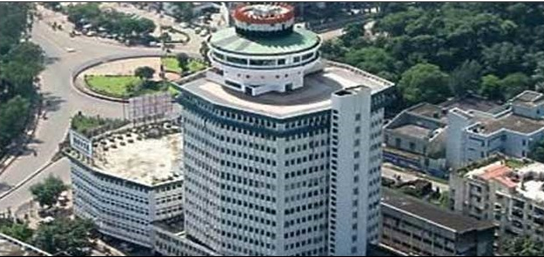
It was a magnificent and thrived largly during the gupta era. During the same era it was destroyed three times and only reconstructed two times. It was ransacked and destroyed by the Delhi Sultanate.
On 25 November 2010, the Indian government, through an Act of Parliament, resurrected the ancient university through the Nalanda University Bill, and subsequently a new Nalanda University was established. It has been designated as an "International University of National Importance."

Slide 4
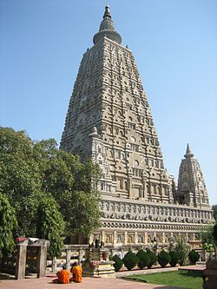
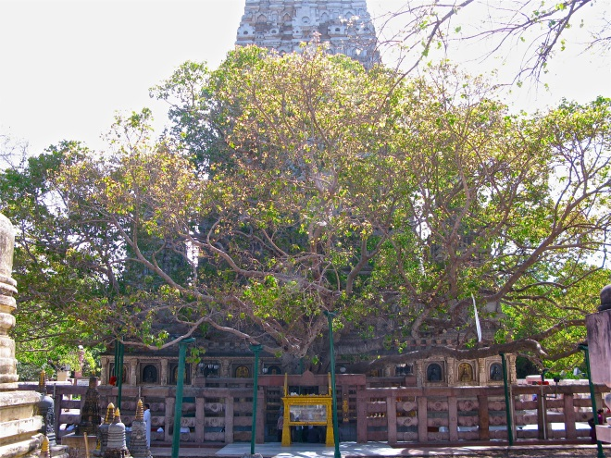
Bodh Gaya
Bodh Gaya is a religious site and place of pilgrimage. It is famous as it is the birthplace of buddhism and also where Gautama Buddha is said to have attained Enlightenment under what became known as the Bodhi Tree.

Slide 5
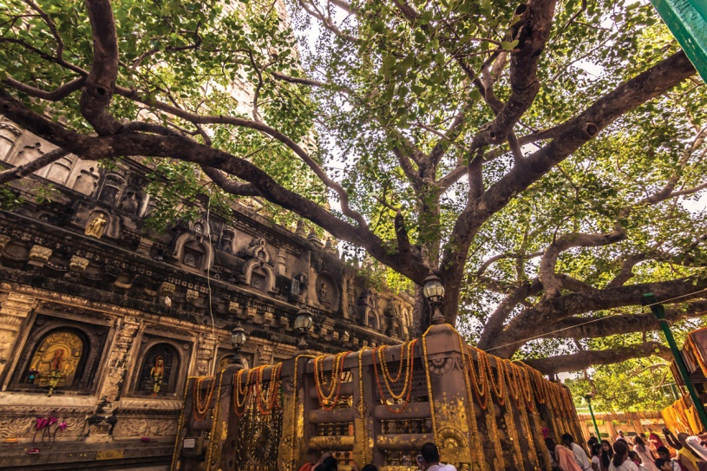

Bodhi Tree
The Bodhi Tree or Bodhi Fig Tree ("tree of awakening") was a large and ancient sacred fig tree, also called the Bo Tree, located in Bodh Gaya, Bihar, India, under which Siddhartha Gautama, the spiritual teacher who became known as the Buddha, is said to have attained enlightenment or Bodhi circa 500 BCE.

Slide 6
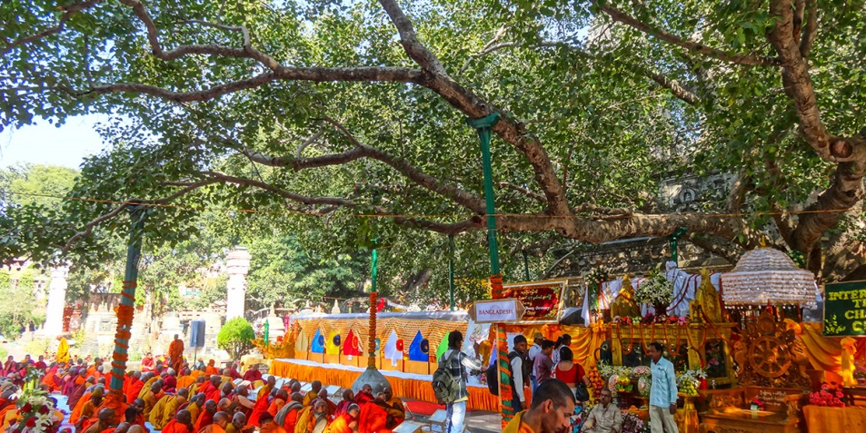
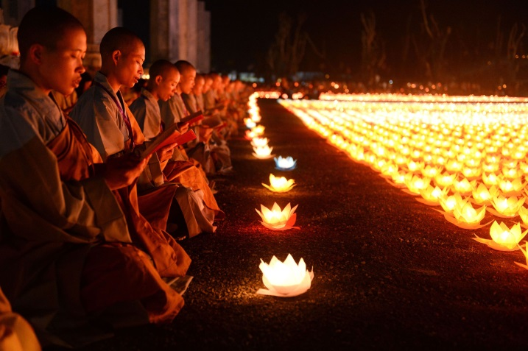
Bodhi Day
On December 8, Bodhi Day celebrates Buddha's enlightenment underneath the Bodhi Tree. Those who follow the Dharma, greet each other by saying, “Budu saranai!” which translates to "may the peace of the Buddha be yours.” It is also generally seen as a religious holiday, much like Christmas in the Christian west, in which special meals are served, especially cookies shaped like hearts (referencing the heart-shaped leaves of the Bodhi) and a meal of kheer, the Buddha's first meal ending his six-year asceticism.

Slide 7
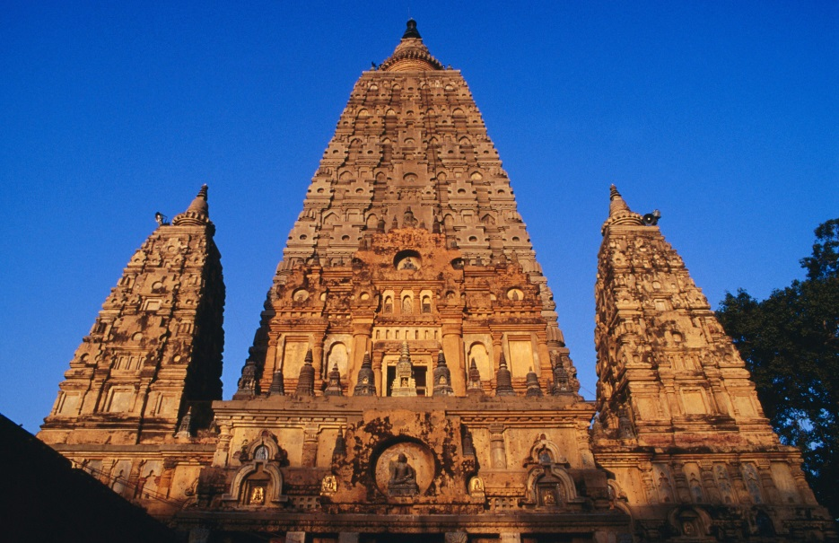
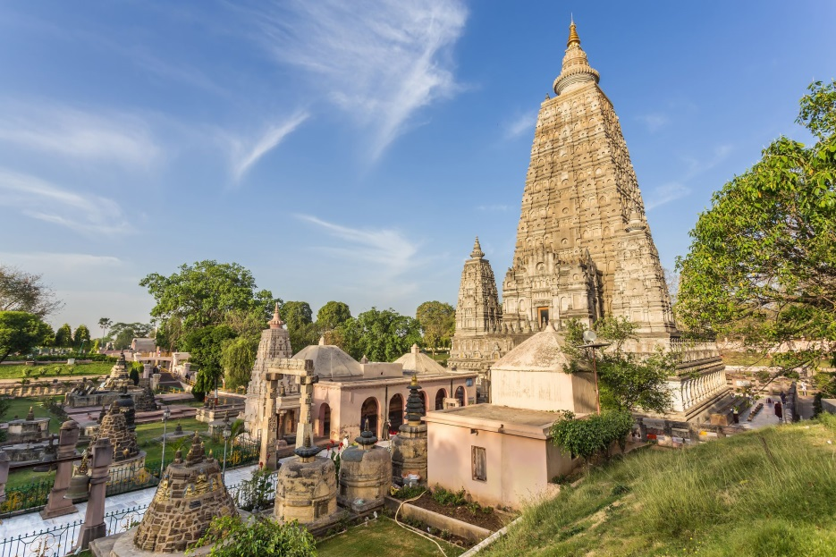
Mahabodhi Temple
The Mahabodhi Temple (literally: "Great Awakening Temple") or the Mahabodhi Mahavihar, a UNESCO World Heritage Site, is an ancient, but much rebuilt and restored, Buddhist temple in Bodh Gaya, marking the location where the Buddha is said to have attained enlightenment.
What is now visible on the ground essentially dates from the 7th century CE, or perhaps somewhat earlier, as well as several major restorations since the 19th century. But the structure now may well incorporate large parts of earlier work, possibly from the 2nd or 3rd century CE.

Slide 8
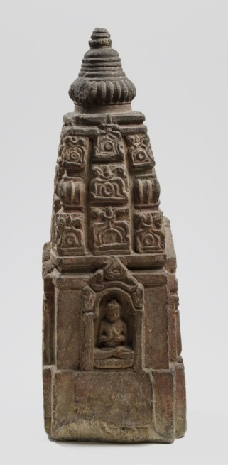
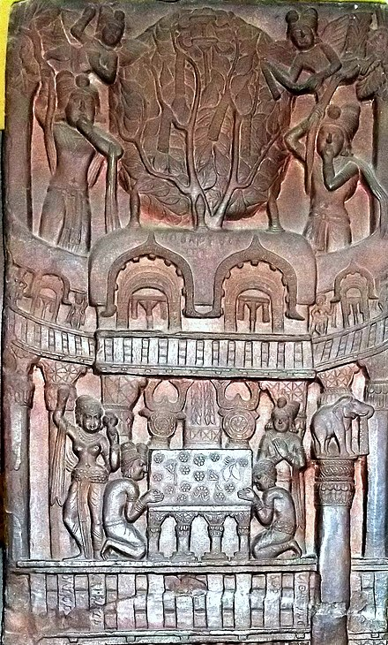
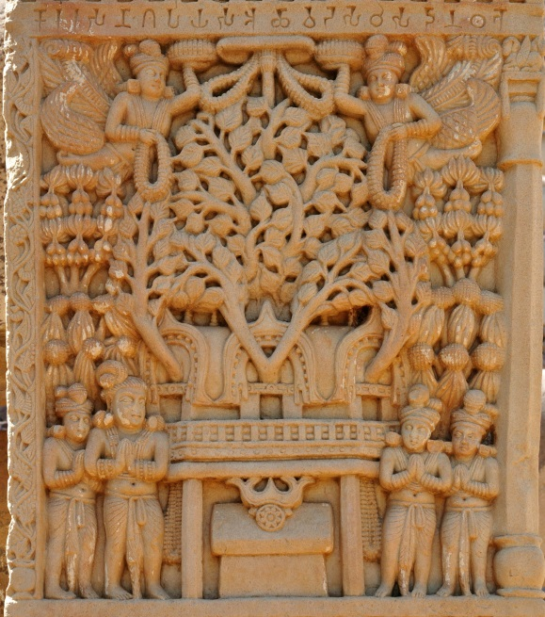
Many of the oldest sculptural elements have been moved to the museum beside the temple, and some, such as the carved stone railing wall around the main structure, have been replaced by replicas. The main temple's survival is especially impressive, as it was mostly made of brick covered with stucco, materials that are much less durable than stone. However, it is understood that very little of the original sculptural decoration has survived.

Slide 9
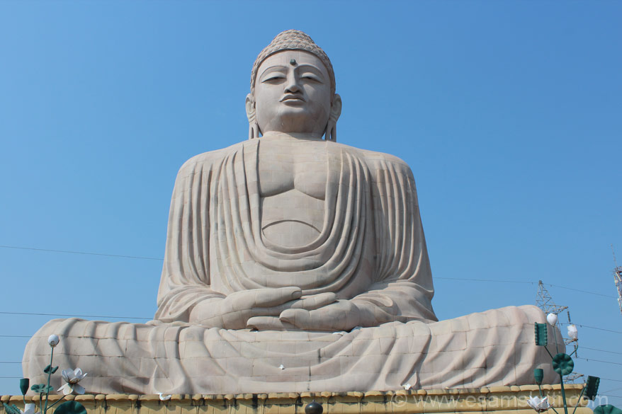
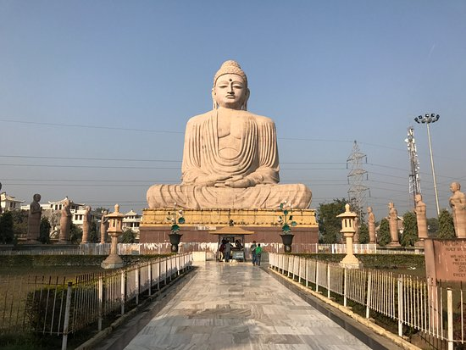
Great Buddha Statue
The Great Buddha statue is one of the many stops on the Buddhist pilgrimage and tourist routes in Bodh Gaya, Bihar. The statue is 19.5 m high representing the Buddha seated in a meditation pose, or dhyana mudra, on a lotus in the open air.
The statue was designed by V. Ganapati Sthapati and took seven years to complete using the labor of 12,000 stonemasons. It is constructed from a combination of sandstone and red granite blocks.

Slide 10
A hollow spiral staircase inside the statue leads from the ground up to the chest. Shelves on the interior walls display 16,300 small bronze images of the Buddha. The Great Buddha is possibly the largest Buddha statue in India at the time and was consecrated on 18 November 1989 by the 14th Dalai Lama. The foundation stone for the statue was laid in 1982.

Slide 11
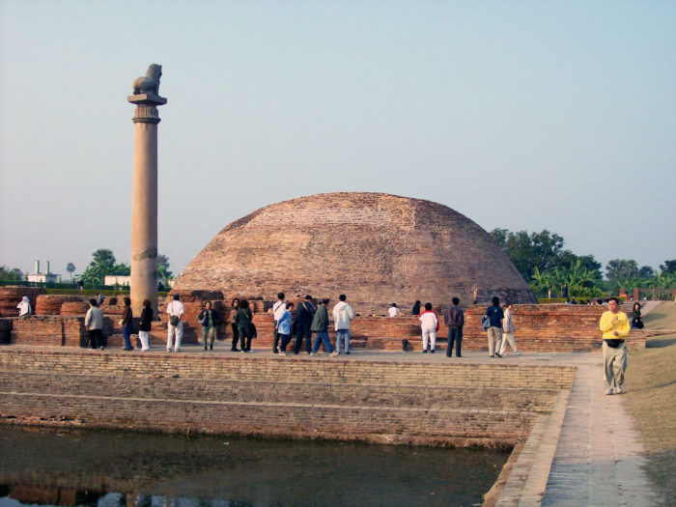
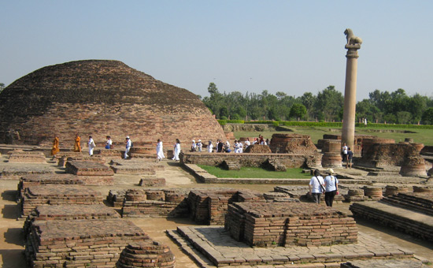
Vaishali
Vaishali or Vesali was a city in present-day Bihar, India, and is now an archaeological site. It is a part of the Tirhut Division.
It was the capital city of the Vajjian Confederacy, considered one of the first examples of a republic around the 6th century BCE. Gautama Buddha preached his last sermon before his death in c. 483 BCE, then in 383 BCE the Second Buddhist council was convened here by King Kalasoka, making it an important place in both Jain and Buddhist religions.

Slide 12
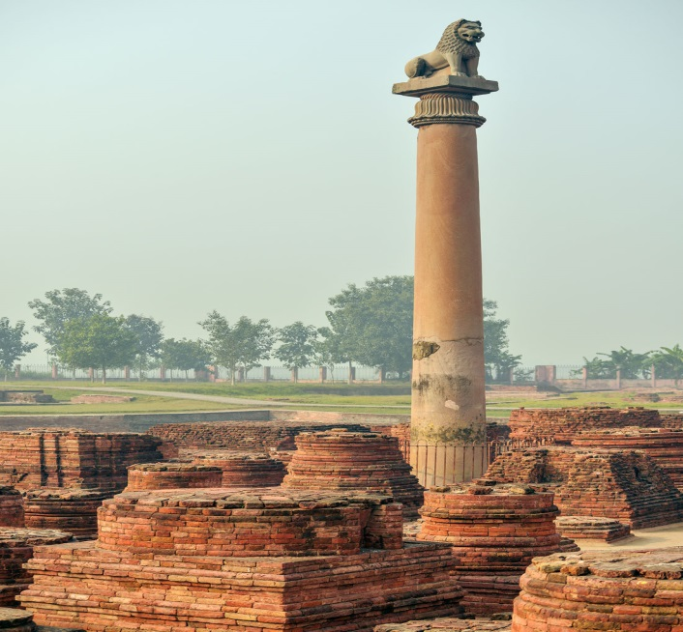
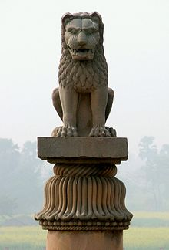
It contains one of the best-preserved of the Pillars of Ashoka, topped by a single Asiatic lion.
It is believed that a republic system was established in Vaishali around 6th century BCE, much before such a system came into existense in Greece.

Slide 13
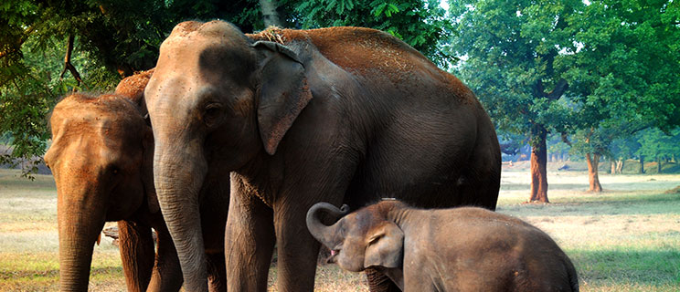
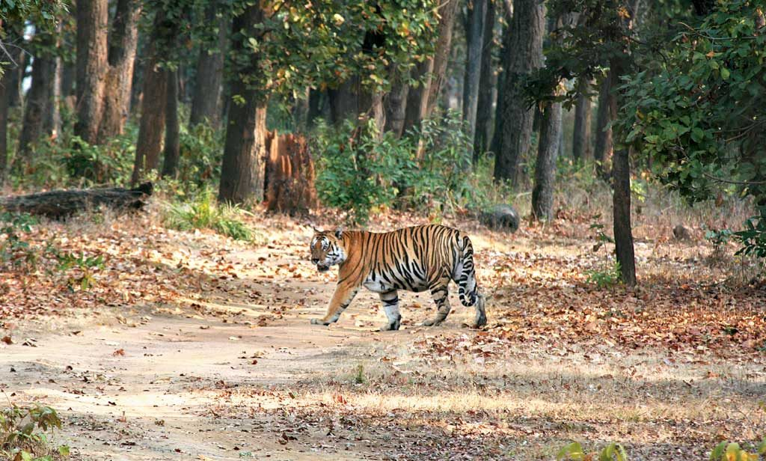
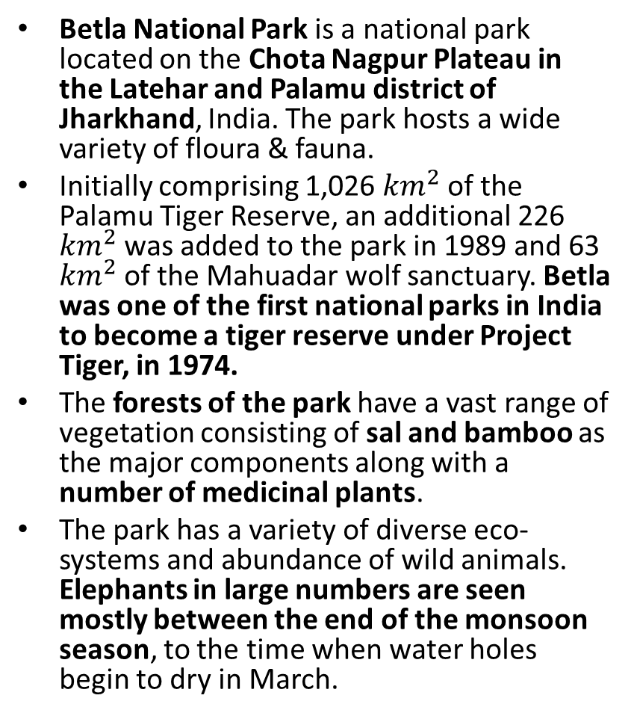
Betla National Park
Betla National Park is a national park located on the Chota Nagpur Plateau in the Latehar and Palamu district of Jharkhand, India. The park hosts a wide variety of floura & fauna.
Initially comprising 1,026 ${km}^{2}$ of the Palamu Tiger Reserve, an additional 226 ${km}^{2}$was added to the park in 1989 and 63 ${km}^{2}$of the Mahuadar wolf sanctuary. Betla was one of the first national parks in India to become a tiger reserve under Project Tiger, in 1974.
The forests of the park have a vast range of vegetation consisting of sal and bamboo as the major components along with a number of medicinal plants.
The park has a variety of diverse eco-systems and abundance of wild animals. Elephants in large numbers are seen mostly between the end of the monsoon season, to the time when water holes begin to dry in March.

Slide 14
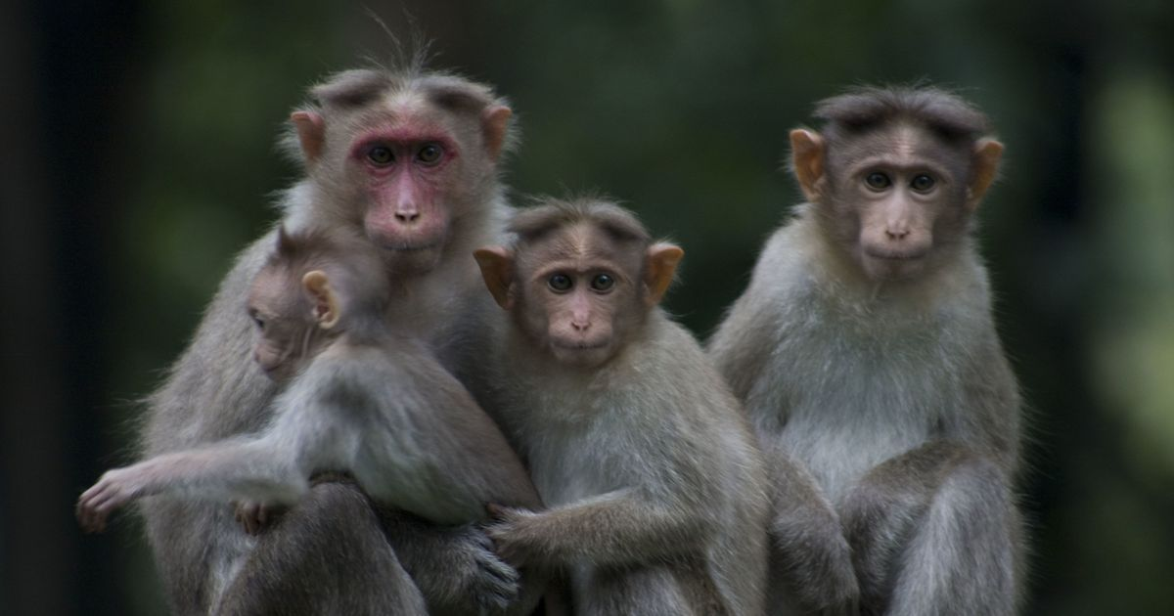
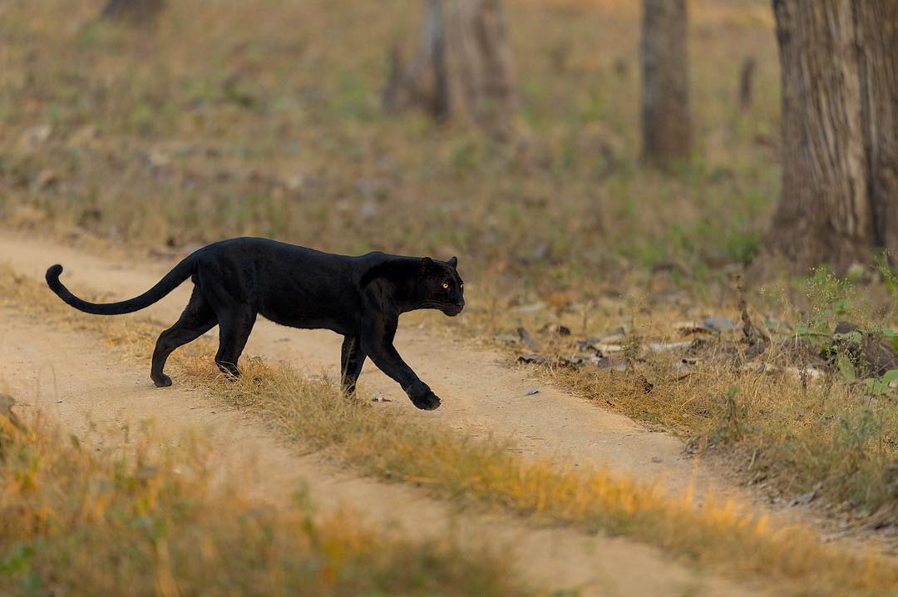
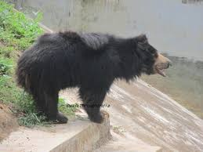
Predators include the sloth bear and panther, while scavengers include the wolf, jackal and hyena. Other animals include large herds of gaur and chital, large families of langurs, rhesus monkeys, Indian giant squirrels, mouse deer, sambhar deer, four-horned antelopes, nilgai, kakar, small Indian civets, ant eating pangolin, porcupine and mongoose. White tigers that remained in the park were transported to zoos.

Slide 15
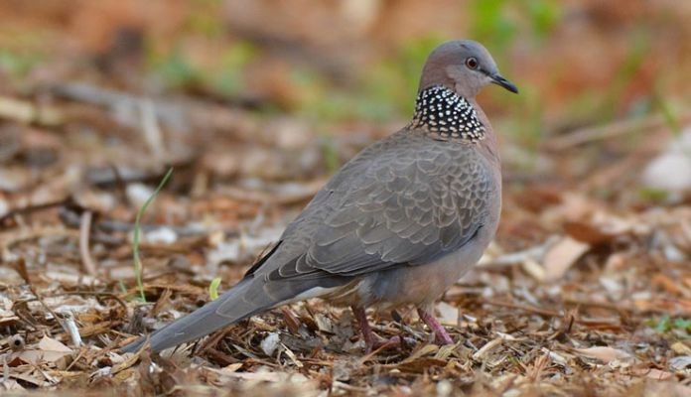
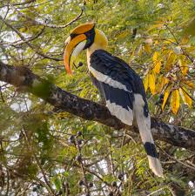
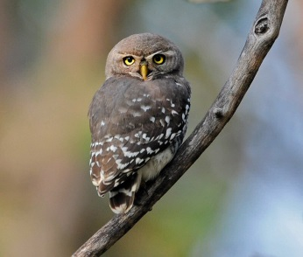
Birds include the hornbill, peafowl, red jungle fowl, black partridge, white-necked stork, black ibis, swamp grey, quail, pied hornbill, wagtail, harial, dove, drongo, crested serpent-eagle, forest owlet, papeeha, and other birds usually found in dry deciduous forests. The Kamaldah lake attracts several varieties of water birds including the common whistling, cotton teal, knob-billed duck, snipe and geese.

Slide 16
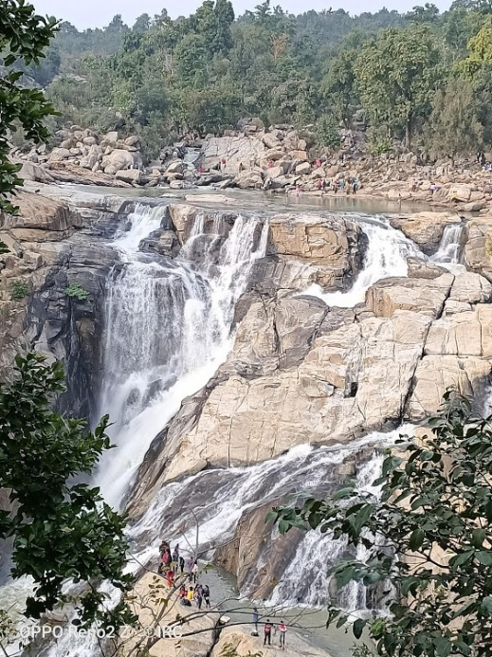
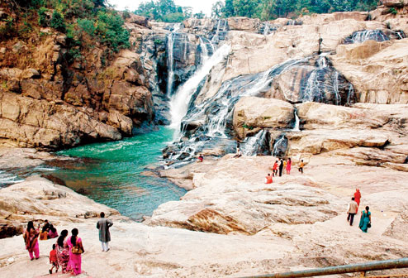
Dasham Falls
The Dassam Falls is a waterfall located near Taimara village in Bundu police station of Ranchi district in the Indian state of Jharkhand.
The Dassam Falls is a natural cascade across the Kanchi River, a tributary of the Subarnarekha River. The water falls from a height of 44 metres. The sound of water echoes all around the place. Dassam Falls at one of the edges of the Ranchi plateau is one of the many scarp falls in the region.

Slide 17
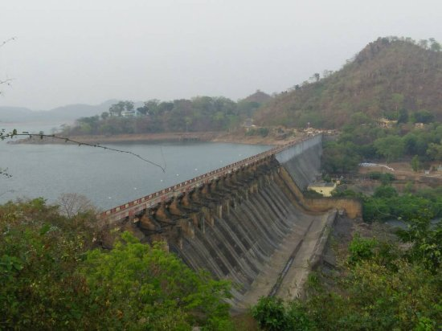
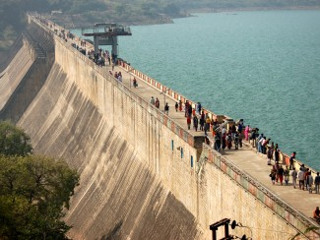
Massanjore Dam
Massanjore Dam is a hydropower generating dam over the Mayurakshi River located at Massanjore near Dumka in the state of Jharkhand, India. The Massanjore dam, across the Mayurakshi, was commissioned in 1955. It was formally inaugurated by Lester B. Pearson, Foreign Minister of Canada. The Mayurakshi River at the dam site has a catchment area of 1869 sq.km
It is 47.25 m high from its base and is 661.58 m long. The reservoir has an area of 67.4 square kilometres when full and has a storage capacity of 620,000,000 cubic metres. The length of the overflow section is 225.60 m and is controlled by 21 bays, each 9.144 m wide. The design discharge is 4.446 cumecs. The full reservoir level is 121.34 m and the flood level is 122.56 m. It cost Rs. 16.10 crore.

Slide 18
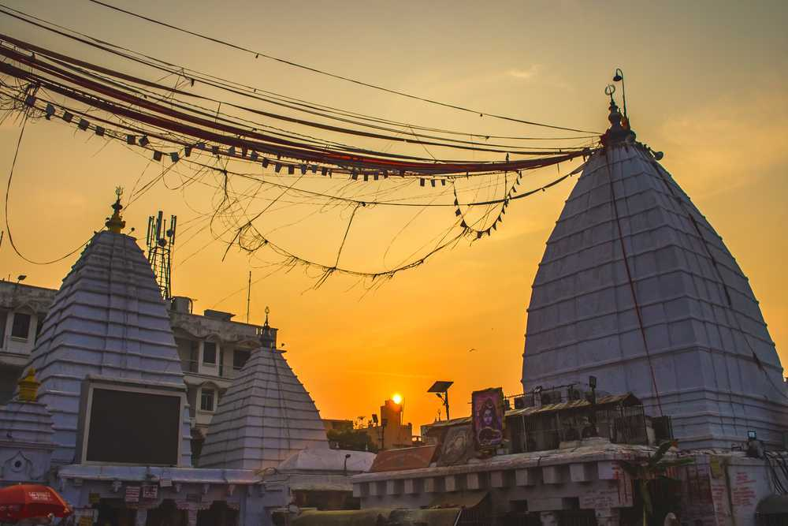
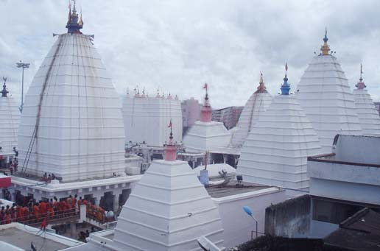
Deoghar
Deoghar (pronounced Devaghar) is a holy sacred place of Hinduism, located in Jharkhand. The sacred temples of the city make this place for pilgrimage and tourist. Also, the city has archaeological and historical value. Ancient Indian books and scripts state the age of the city is Vedic or before Vedic period.
Deoghar is a Hindi word and the literal meaning of ‘Deoghar’ is abode (‘ghar’) of the Gods and Goddesses (‘dev’). Deoghar is a place of worship for Lord Shiva, in the month of Shravan many devotee takes ganga jal from Sultanganj to Deoghar for worship and they get the desired wish of their life.

Slide 19
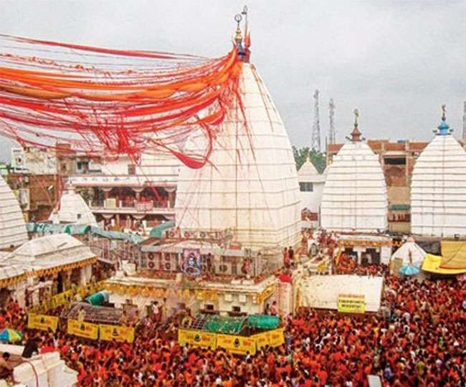
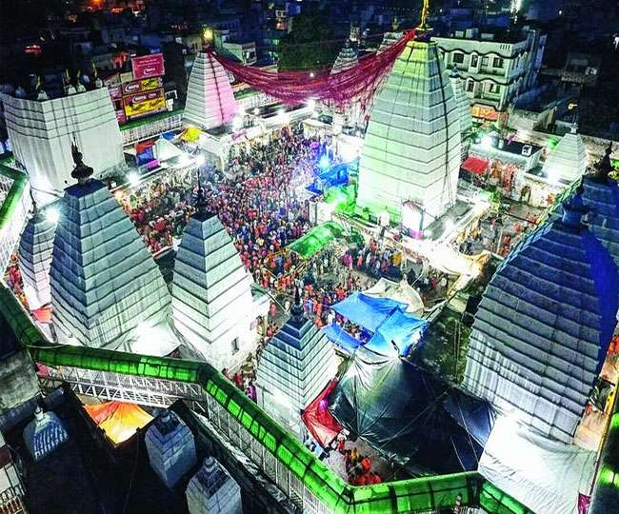
Each year between July and August (on the eve of the month of Shrawan) in Deoghar Yatra, about 7 to 8 million devotees come from various part of India bringing holy water from various areas of Ganges at Sultanganj, which is almost 108 km from Deoghar, in order to offer it to Lord Shiva. During that month, a line of people in saffron-dyed clothes stretches over the full 108 km. It is the longest Mela of Asia.

Slide 20
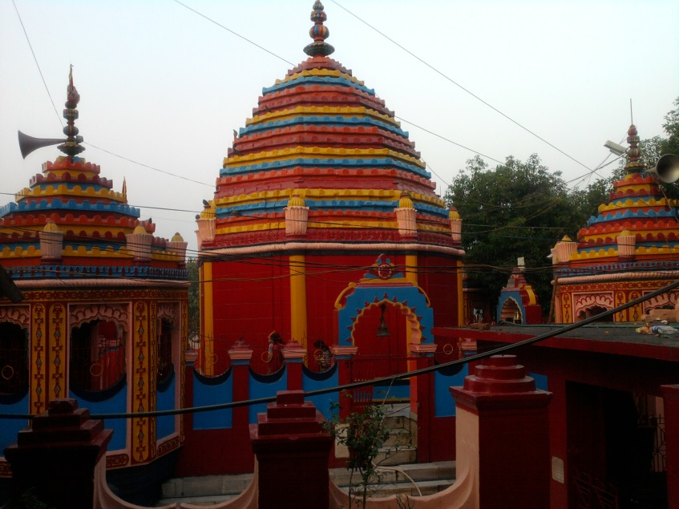
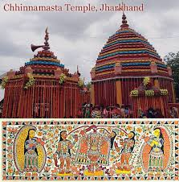
Chhinnamasta Temple
Chhinnamastika Temple dedicated to Goddess Chinnamasta is a Hindu pilgrimage centre and located in Rajrappa, in Ramgarh district of Jharkhand, India.The place attracts devotees from all parts of Bihar, Jharkhand and West Bengal.
The main attraction of the Chhinnamasta (also known as Chinnamastika) temple is the headless deity of Goddess Chinnamasta which stands on the body of Kamadeva and Rati in the lotus bed. The Chhinnamasta temple is popular for its Tantrik style of architectural design. Apart from the main temple, there are ten temples of various gods and goddesses such as the Surya (Sun God), Hanuman and Lord Shiva.

Slide 21
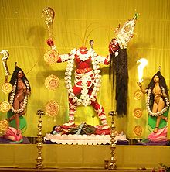
The temple enshrines the Goddess Chinnamasta (the beheaded Goddess Kali), one of the ten forms of the Goddess Durga. The statue shows the goddess holding her own head in her left hand and her head drinking the blood oozing out of her neck. The headless idol of Goddess Chhinnamastika stands on the body of Kamdeo and Rati in Lotus bed.

Slide 22
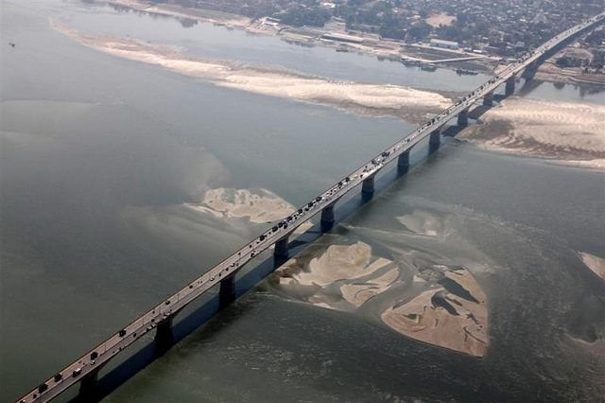
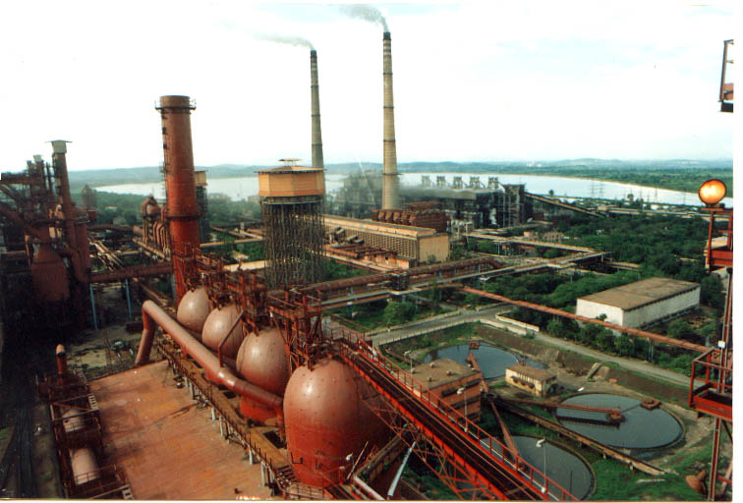
Other Places of Interest
Mahatma Gandhi Setu is a bridge over the river Ganges in Bihar, India, connecting Patna in the south to Hajipur in the north. Its length is 5,750 metres and it is the third-longest river bridge in India.
Bokaro Steel City Or simply Bokaro, is one of the planned cities of India and also an urban aggloromeration, a major industrial centre and the fourth largest city in the Indian state of Jharkhand.

Slide 23
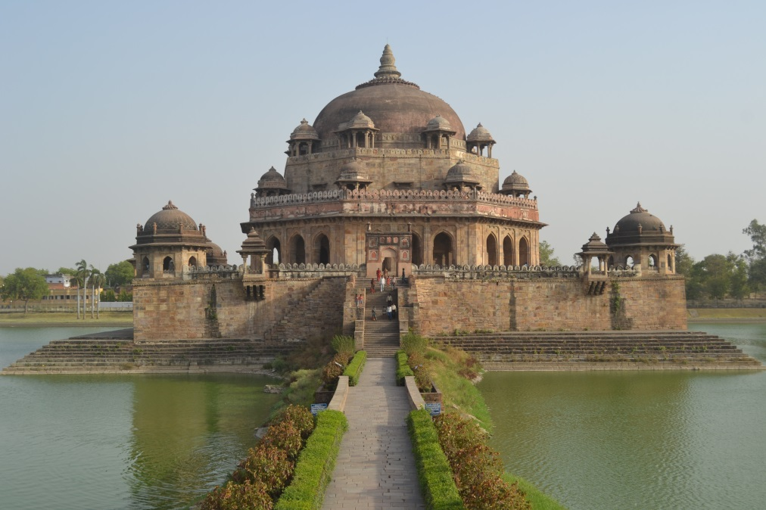
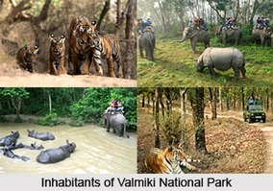
The tomb of Sher Shah Suri is in the Sasaram town of Bihar state, India. The tomb was built in memory of Emperor Sher Shah Suri, a Pathan from Bihar who defeated the Mughal Empire and founded the Suri Empire in northern India.
Valmiki National Park, Tiger Reserve and Wildlife Sanctuary is located at the India-Nepal border in the West Champaran district of Bihar, India on the bank of river Gandak. It is the only National park in Bihar.

Slide 24


Munger is a twin city and a Municipal Corporation situated in the Indian state of Bihar. Munger is known for its manufacturing of iron articles such as firearms and swords. It is ancient city of Mahabharata legend Karna, the eldest son of Kunti and Sun Lord.
Langat Singh College, commonly known as L. S. College, is a college in Muzaffarpur, in the Indian state of Bihar. It is also know that Dr. Rajendra Prasad, the first president of India was a faculty member in the department of history.

